Slide 1

Weekly Report

Slide 2
Progress 10 November 2020 – 15 Desember 2020
Membuat Trello baru
Syarat & Ketentuan
About Us
Kebijakan Privasi
Quick Trade
Melanjutkan coding bagian aplikasi
Instagram

Slide 3



Content Instagram
Feed Instagram

Slide 4
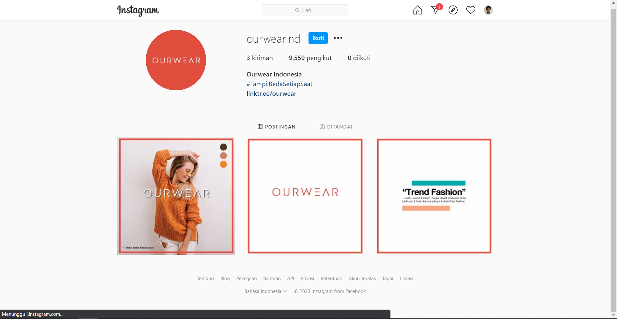
Instagram
Profile instagram
Intagram.com/ourwearind

Slide 5
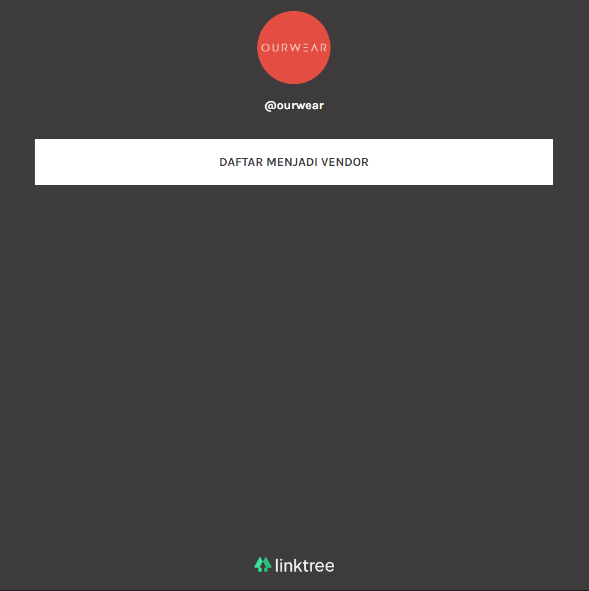
Linktree
Hub fungsionalitas Ourwear
Linktr.ee/ourwear

Slide 6
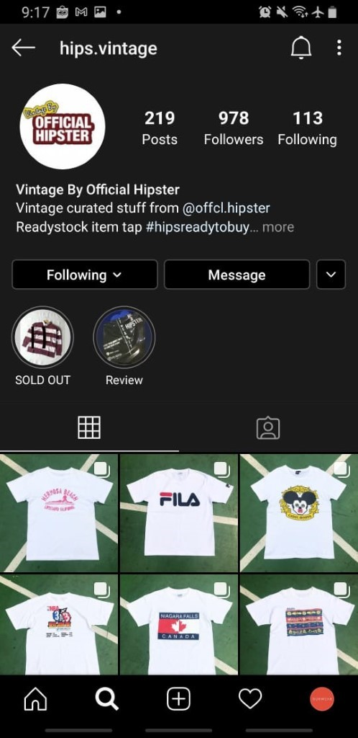
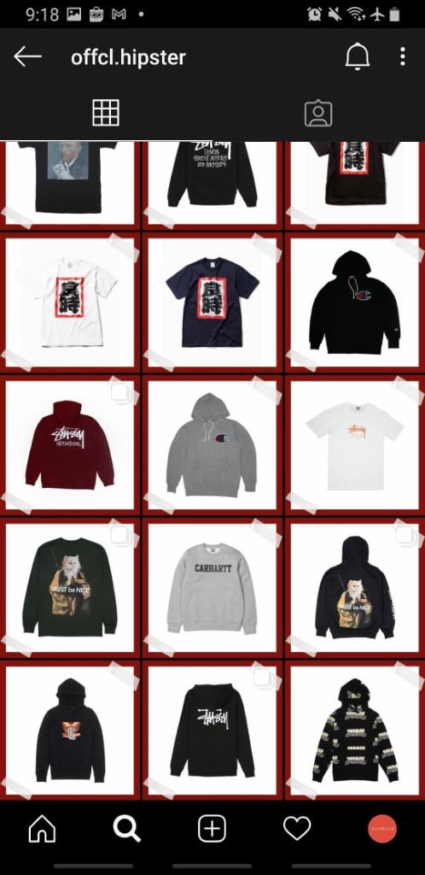
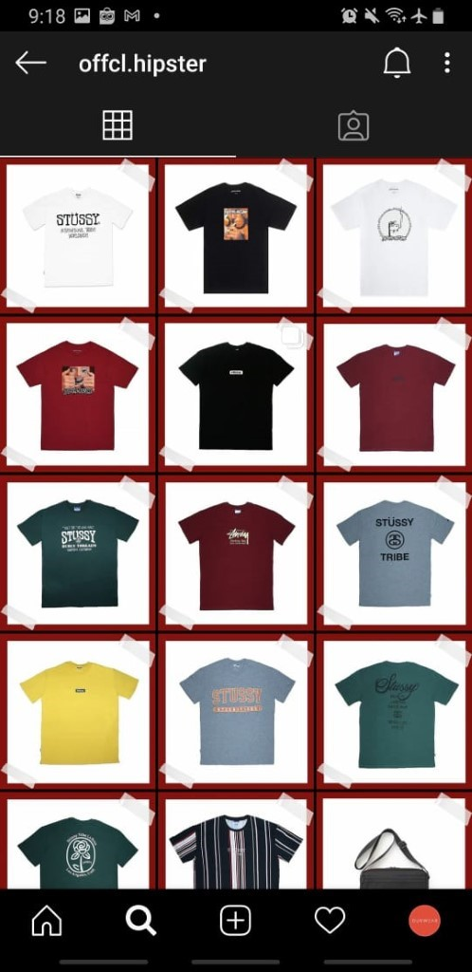
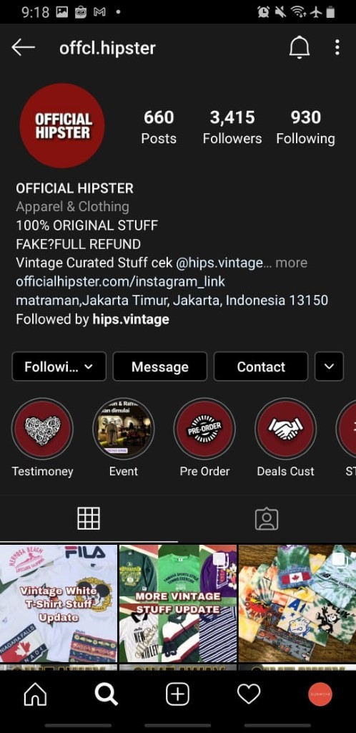
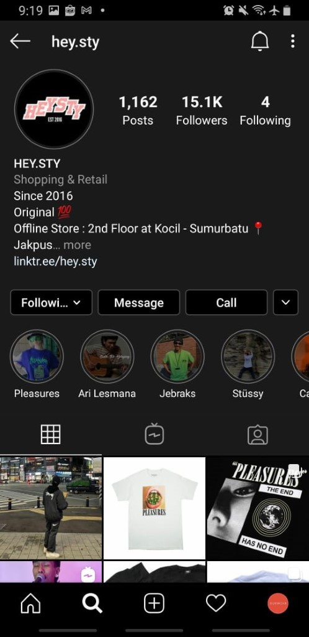
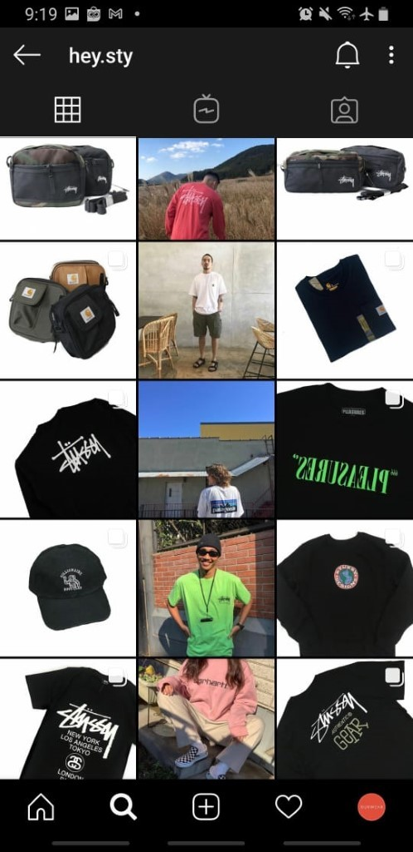
Partner
Hips Vintage
Official Hipster
Heys.sty

Slide 7
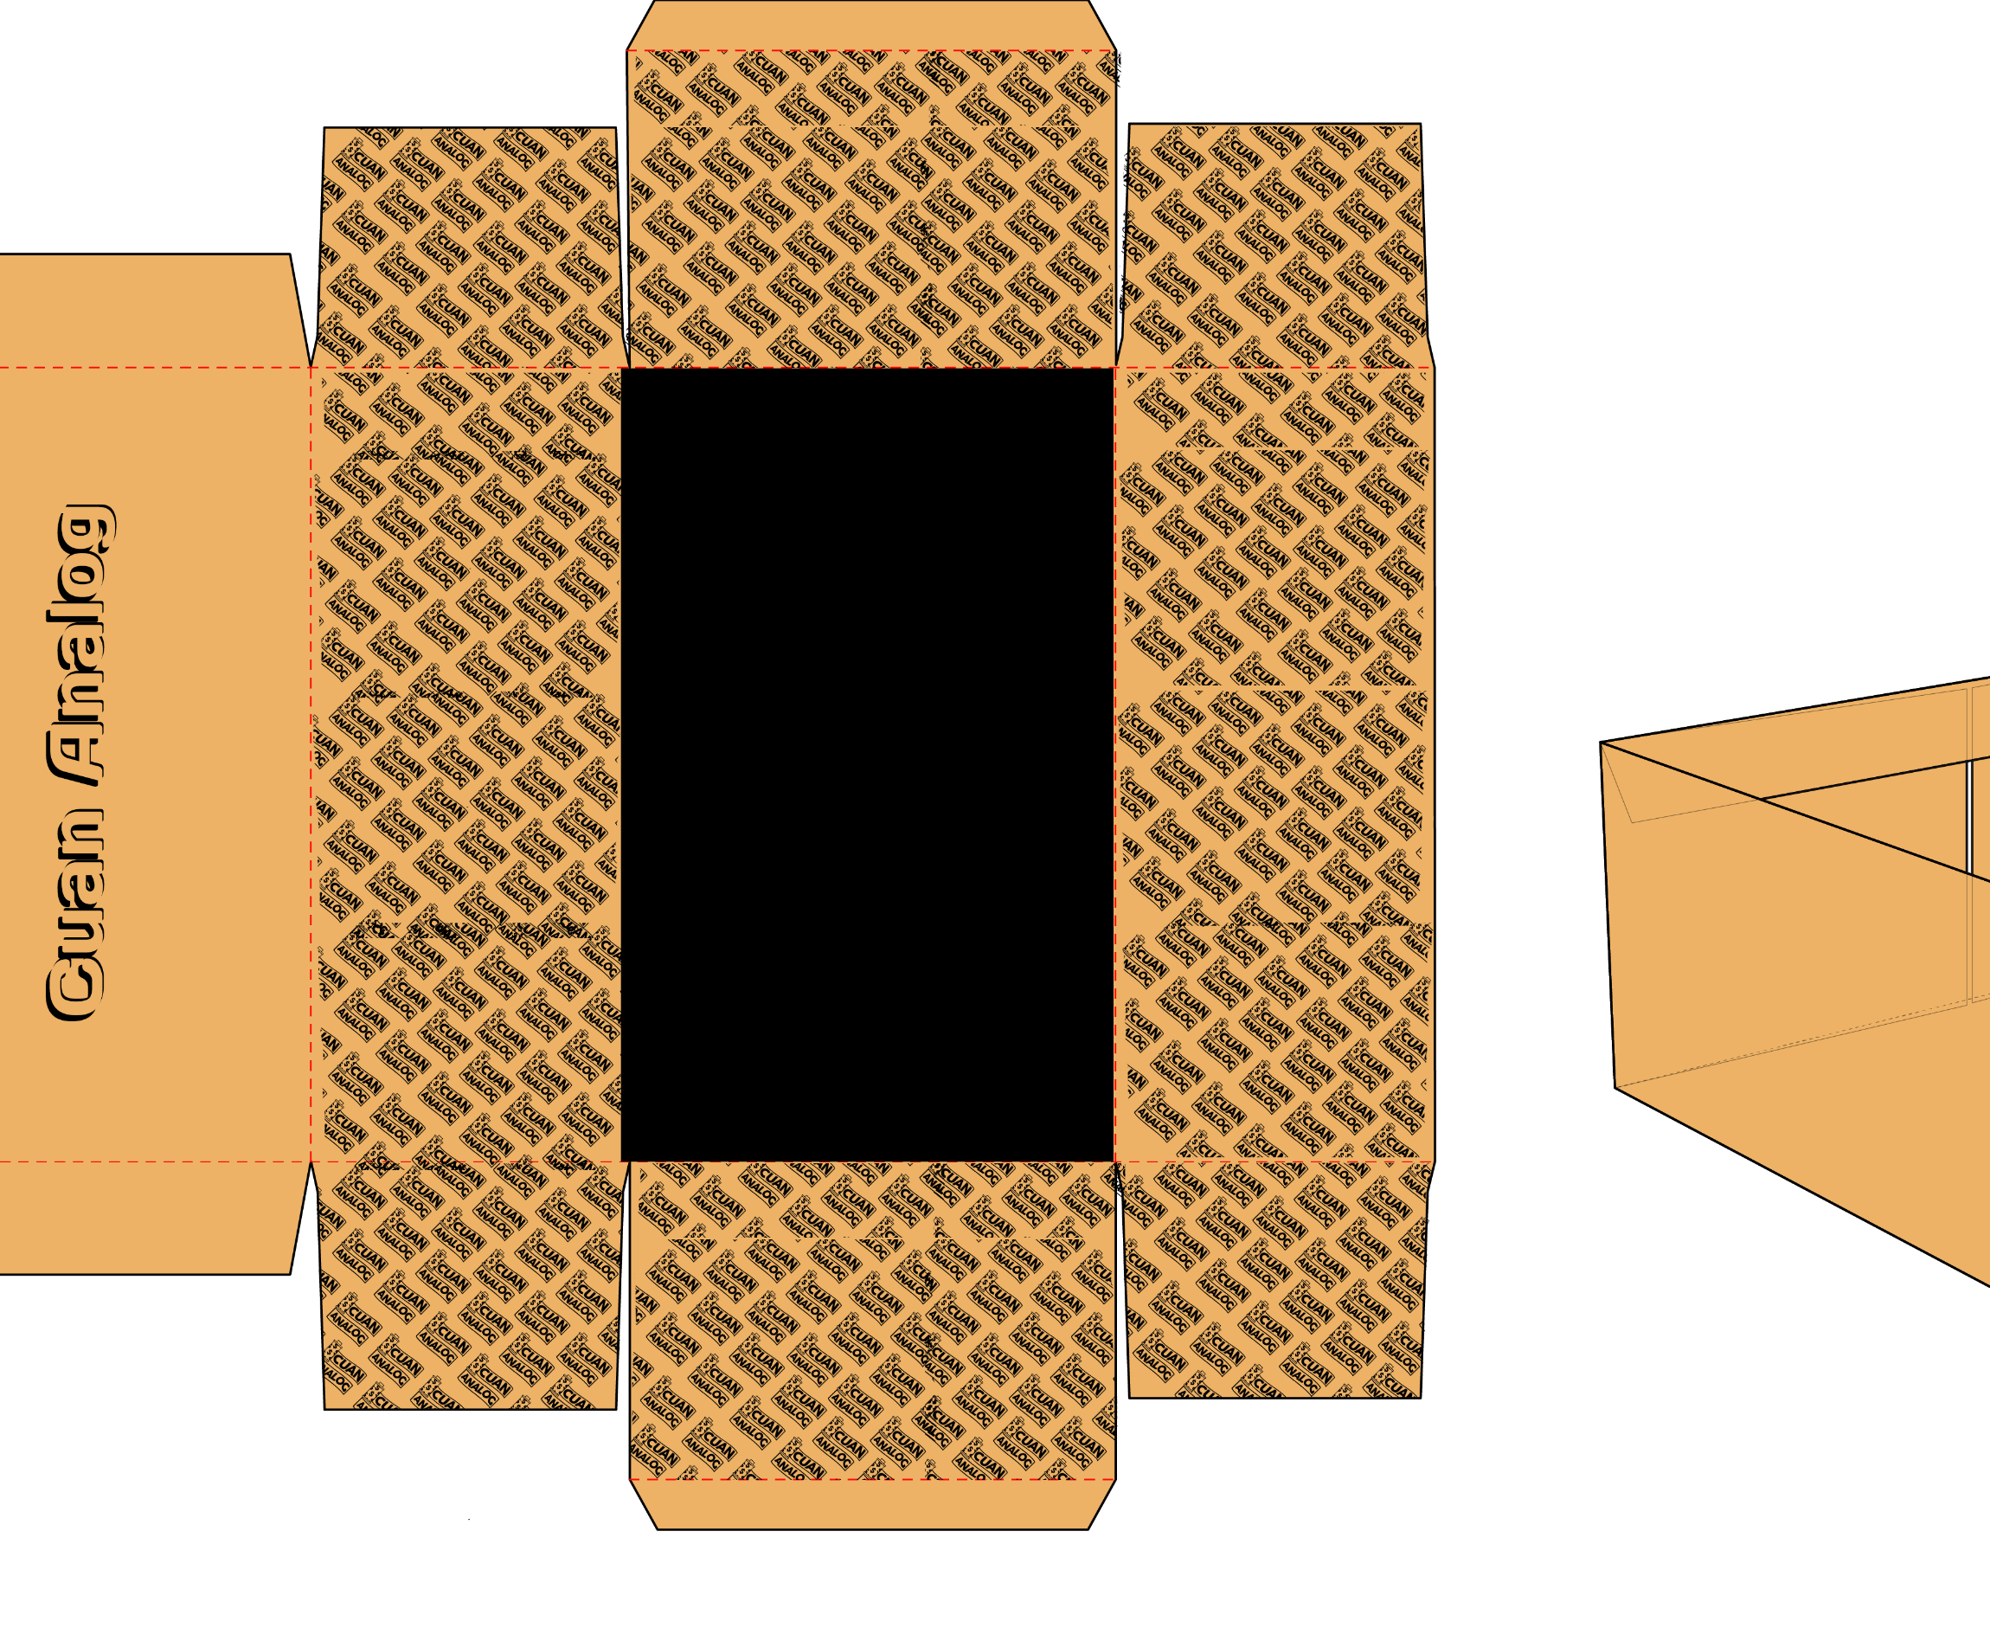
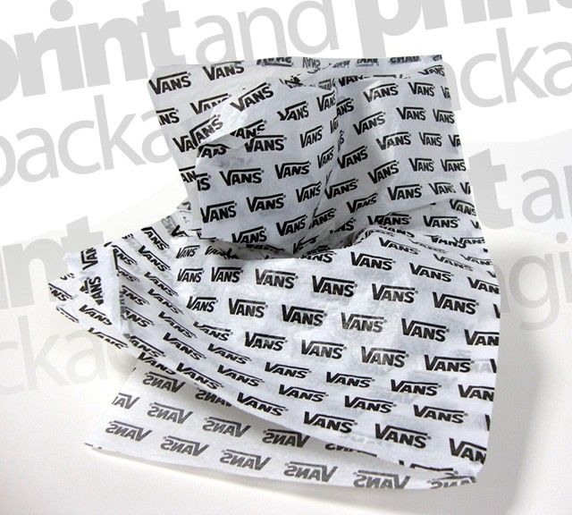
Packaging Proposal
Contoh Design untuk packaging
Seperti apa packagingnya yang bagus nanti?
Bagaimana untuk meletakkan instruksi pengembalian?
Cara pengiriman?

Slide 8
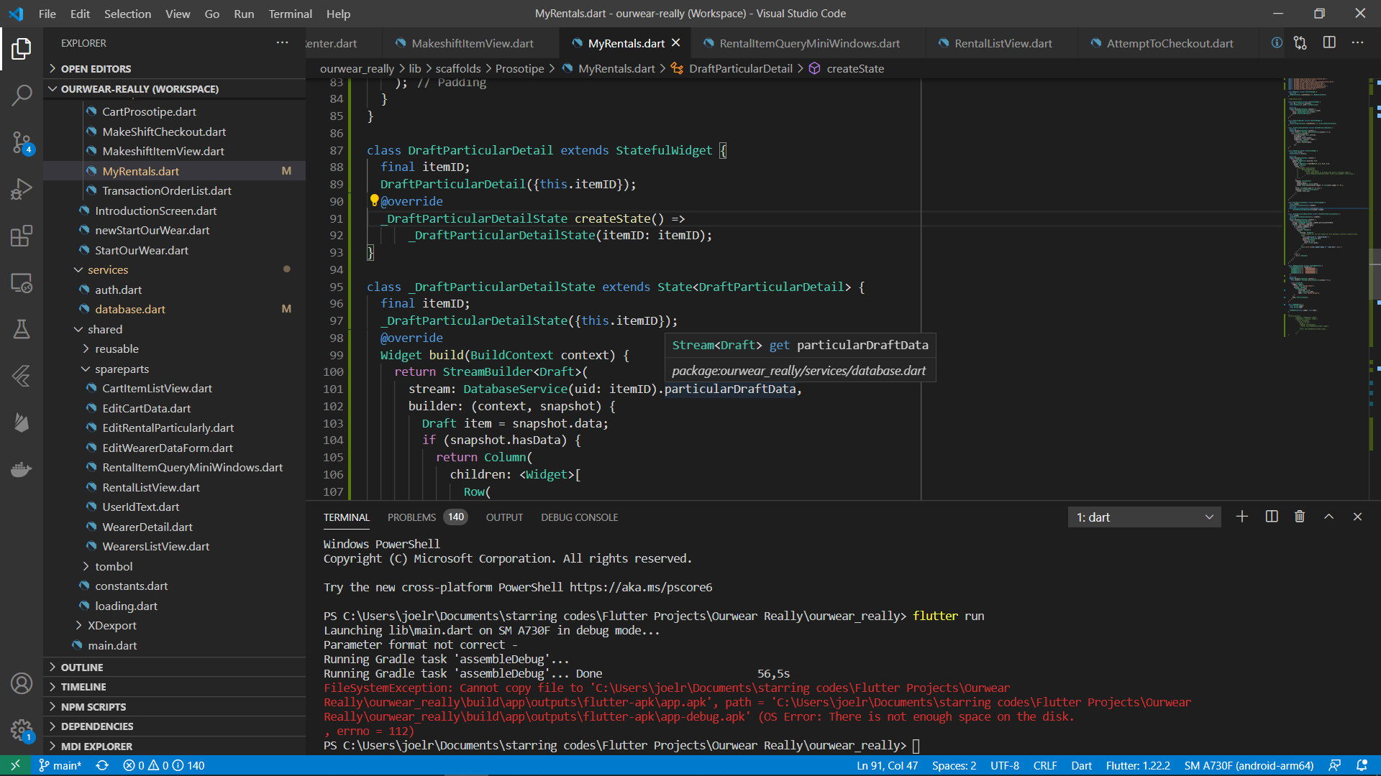
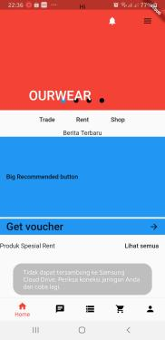
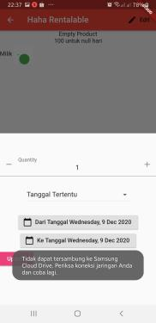
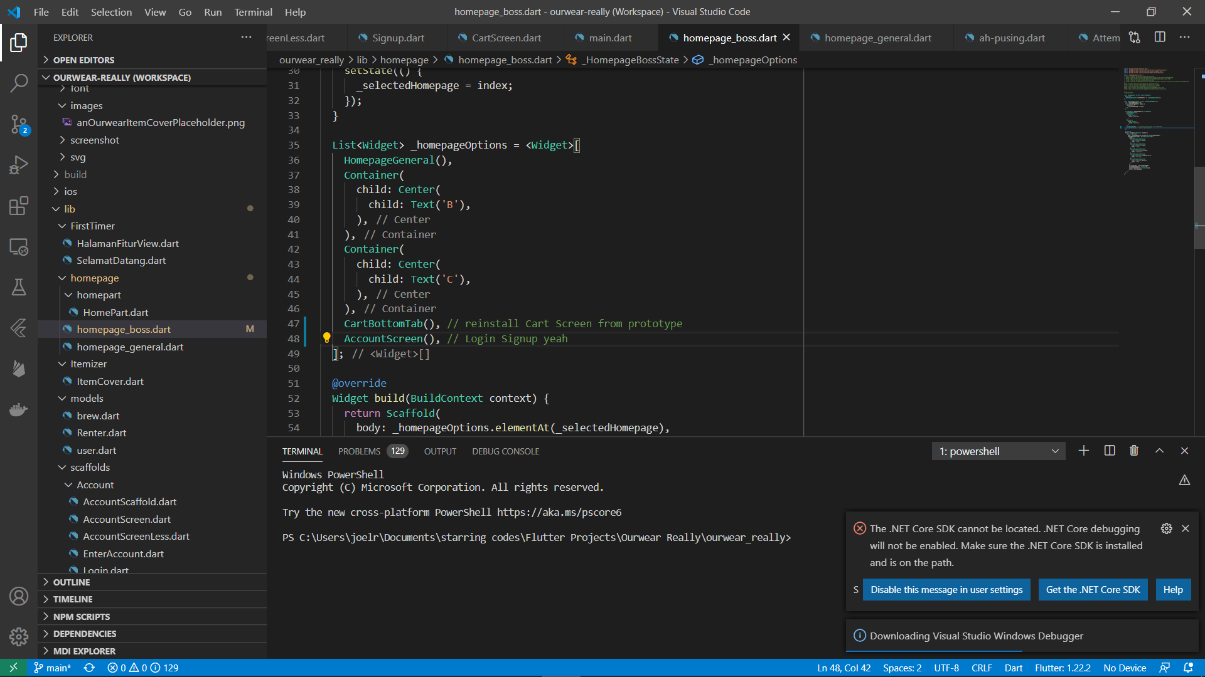
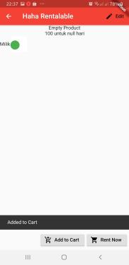
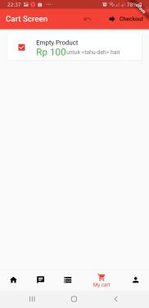
Coding
Cart
Account sign in sign up
Edit account data
Placeholder Payment method
Transaction
Draft
dsb

Slide 9
Target aplikasi
Instagram
Web
mobile

Slide 10
Rencana domain
“ourwear.com”
https://www.brandbucket.com/names/ourwear?source=ext

Slide 11
Doing Trello
Syarat Ketentuan
About Us
Kebijakan Privasi
Quick trade
XD akun
App dev
Feed instagram

Slide 12
To do Trello
Payment
Packaging
Proses Bisnis langganan
Quick rent
Copywriting
Vendor clothing & Laundry
Chip & Scanner tracking
XD penarikan saldo
XD tukar tambah uang dalam trade

